Slide 1




Thynk
Unlimited.
Home
About
Content
Others
Common Internal & External Factors Leading to
Delivery Delays
+123-456-789
www.reallygreatsite.com
Next Slide | Delivery Delays Presentation

Slide 2

Thynk
Unlimited.
Home
About
Content
Others
The Challenge of Delivery Delays
Over 60% of businesses report delivery delays as a top operational challenge. Timely delivery is critical — it directly affects customer trust, brand reputation, and repeat business. When shipments arrive late, businesses face lost sales, negative reviews, and declining customer loyalty. In today's competitive market, meeting delivery expectations is no longer optional.

Slide 3
Thynk
Unlimited.
Home
About
Content
Others
Common Internal Factors Causing Delays
Internal factors that lead to delivery delays include: inventory management issues such as stockouts and inaccuracies; inefficient order processing systems that slow fulfillment; workforce challenges including staff shortages and training gaps; and equipment or technology failures that disrupt operations. Addressing these issues is key to improving delivery performance.

Slide 4
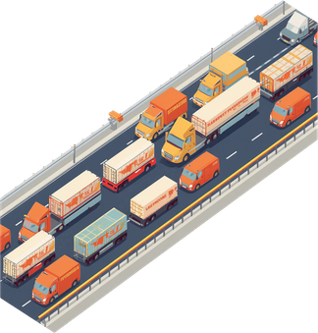
Thynk
Unlimited.
Home
About
Content
Others
Common External Factors Causing Delays
External factors beyond a business's control can significantly disrupt delivery timelines:
• Supplier delays or disruptions in the supply chain
• Transportation and logistics bottlenecks
• Severe weather and natural events
• Regulatory or customs clearance issues
Proactive planning and resilient supply chains help mitigate these risks.

Slide 5
Thynk
Unlimited.
Home
About
Content
Others
Impact on Customer Satisfaction
75% of customers are less likely to reorder after a delayed delivery. Delays erode trust, trigger negative reviews, and directly result in lost sales. Repeated delivery failures damage brand reputation and reduce long-term customer loyalty, making timely delivery a critical factor in business success.
Next Slide | Delivery Delays Presentation

Slide 6
Thynk
Unlimited.
Home
About
Content
Others
Summary & Business Implications
Address internal inefficiencies through process improvements and technology upgrades. Build resilient supply chains to mitigate external risks and disruptions. Communicate proactively with customers to manage expectations and maintain trust. Prioritize customer experience to sustain satisfaction despite operational challenges.

Slide 7
Thynk
Unlimited.
Home
About
Content
Others
Thank You
for Your Attention
Questions & Discussion Welcome
www.reallygreatsite.com
hello@reallygreatsite.com

